Slide 1
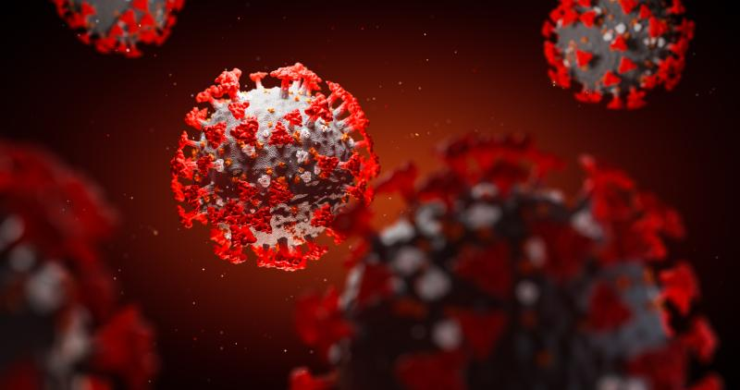
X.A.C.I.
X-Ray Aided Coronavirus Identification

Slide 2
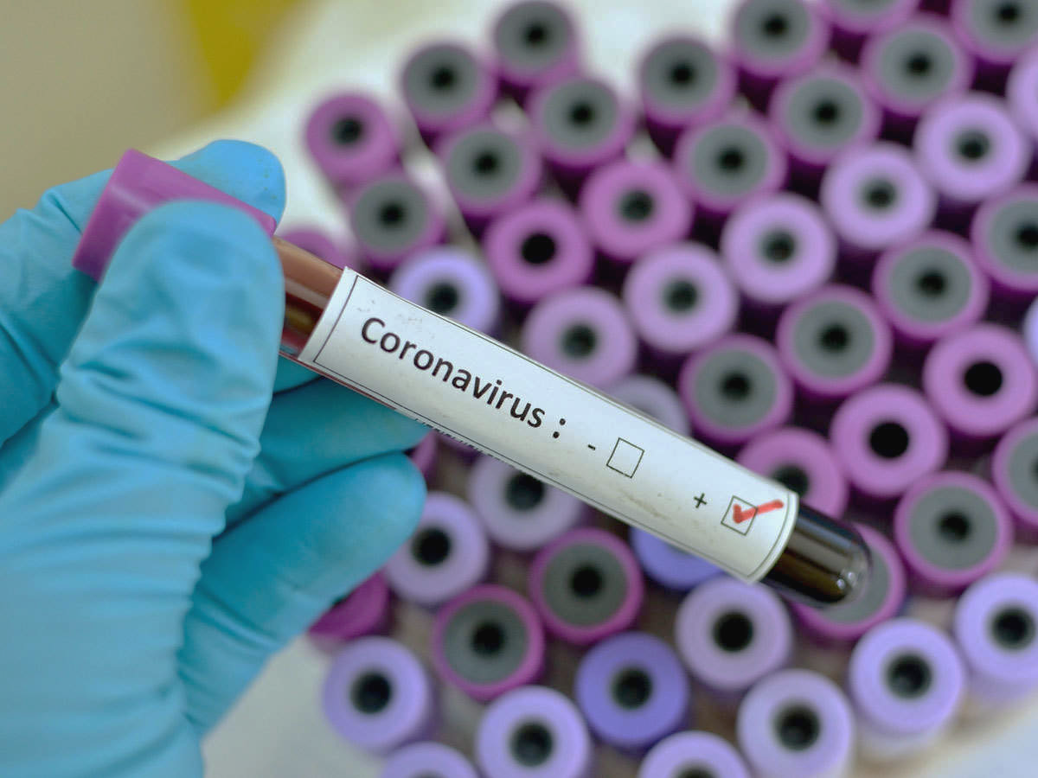
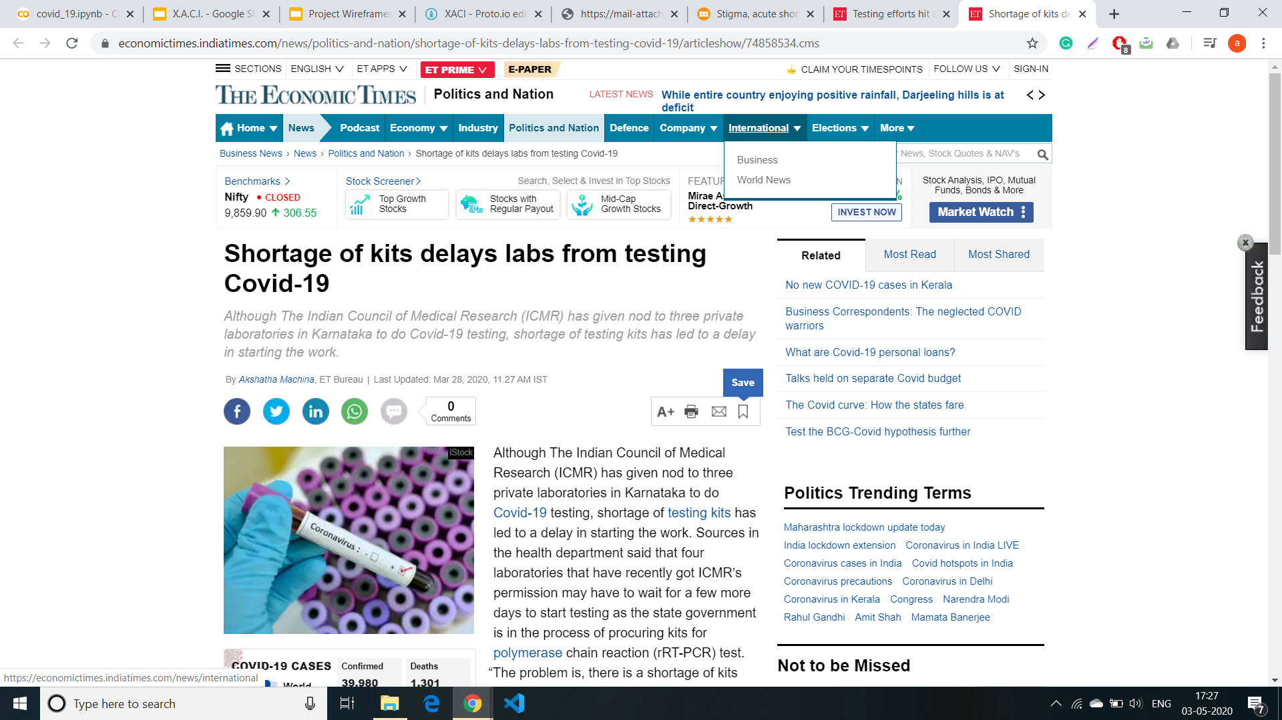
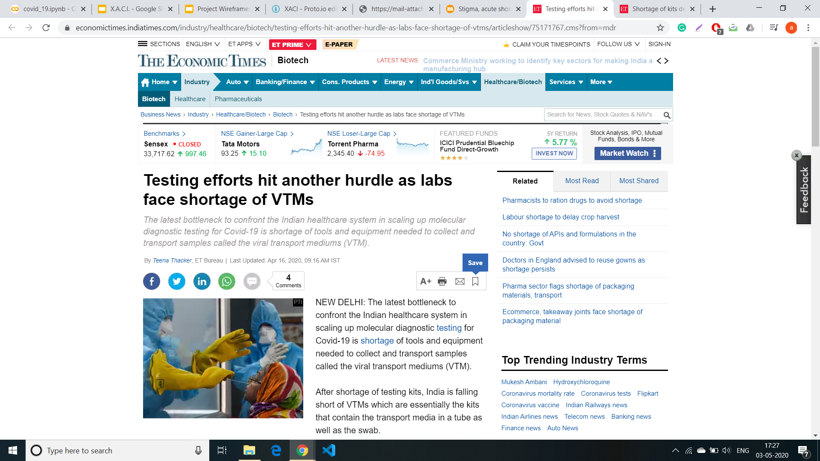
Problem:
Exponentially increasing cases are causing an acute shortage of PCR testing-kits which are considered to be the most effective for COVID identification
Inaccuracy and controversies relating to rapid antibody test kits.
Time taken varies between 30 mins for antibody test to upto 6 hours for PCR test.

Slide 3
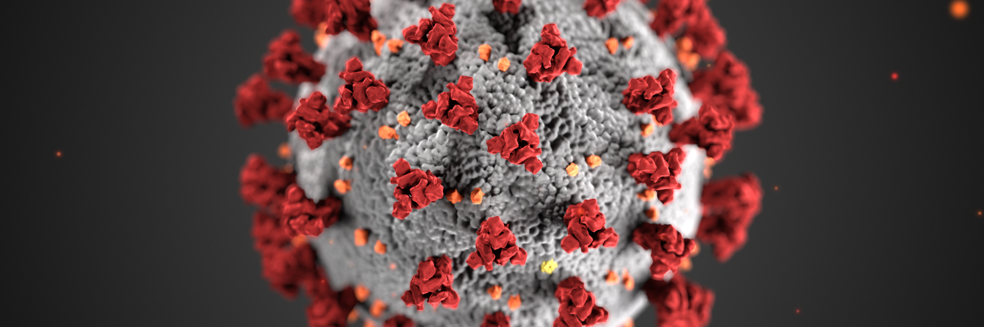
Possible alternative:
A deep learning model deployed through a mobile app which can be used in the event of unavailability of test kits to detect COVID mainly by chest X-Ray scan and supported by some preliminary lab tests.
A machine learning model that takes as input general blood test parameters can be used to confirm suspected cases of COVID-19.

Slide 4
How can it help:
Even in remote areas X-Ray facility is available in India. In the event of unavailability of test kits doctor can use the app to upload patients chest X-Ray image and get the probability of patient being infected with corona. Combined with the blood sample parameters, it can provide a two fold testing.
We are not asking the doctors to blindly believe the results but rather we are using tools to display the unique features of that X-Ray image which are responsible for the outcome predicted.
It is a challenging task to provide expert clinicians to every hospital due to the limited number of radiologists. Therefore, simple, accurate, and fast AI models may be helpful to overcome this problem and provide timely assistance to patients. Although radiologists play a key role due to their vast experience in this field, the AI technologies in radiology can be assistive to obtain accurate diagnosis
Notes:
. Additionally, AI approaches can be useful in eliminating disadvantages such as insufficient number of available RT-PCR test kits, test costs, and waiting time of test results.

Slide 5
Why X-Ray?
Chinese clinical centers had insufficient test kits, which are also producing a high rate of false-negative results, so doctors are encouraged to make a diagnosis only based on clinical and chest CT results
Radiologic images obtained from COVID-19 cases contain useful information for diagnostics. Some studies have encountered changes in chest X-ray and CT images before the beginning of COVID-19 symptoms
Some features:
Right infrahilar airspace opacities in a COVID-19 patients
One in three patients studied had a single nodular opacity in the left lower lung region. In contrast, the other two had four and five irregular opacities in both lungs.
not only found ground-glass opacities (GGO) or mixed GGO in most of the patients, but they also observed a consolidation, and vascular dilation in the lesion
Features by: Kong, W., & Agarwal, P. P.,Yoon, S. H., Lee, K. H., Li, Y., & Xia, L
Notes:
At the beginning of the pandemic, Chinese clinical centers had insufficient test kits, which are also producing a high rate of false-negative results, so doctors were encouraged to make a diagnosis only based on clinical and chest CT results. CT is widely used for COVID-19 detection in countries such as Turkey, where a low number of test kits at onset of the pandemic were available. Researchers state that combining clinical image features with laboratory results may help in early detection of COVID-19 . Radiologic images obtained from COVID-19 cases contain useful information for diagnostics. Some studies have encountered changes in chest X-ray and CT images before the beginning of COVID-19 symptoms . Significant discoveries have been realized by investigators in imaging studies of COVID-19. Kong et al. observed right infrahilar airspace opacities in a COVID-19 patient. Yoon et al. reported that one in three patients studied had a single nodular opacity in the left lower lung region. In contrast, the other two had four and five irregular opacities in both lungs. Zhao not only found ground-glass opacities (GGO) or mixed GGO in most of the patients, but they also observed a consolidation, and vascular dilation in the lesion. Li and Xia reported GGO and consolidation, interlobular septal thickening and air bronchogram sign, with or without vascular expansion, as common CT features of COVID-19 patients. Peripheral focal or multifocal GGO affecting both lungs in 50% - 75% of patients is another observation. Similarly, Zu et al. and Chung discovered that 33% of chest CTs can have rounded lung opacities

Slide 6
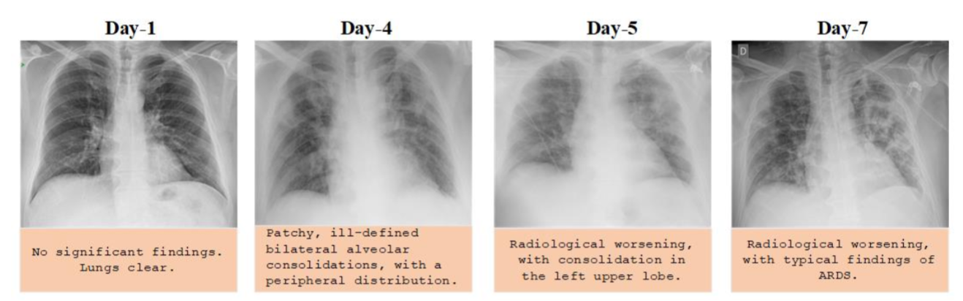
Chest X-Ray images of a 50 year old COVID-19 patient with pneumonia over a week.
Edgar Lorente, COVID-19 pneumonia - evolution over a week, https://radiopaedia.org/cases/COVID19-pneumonia-evolution-over-a-week-1?lang=us
Notes:
Here is a chest ray image of a 50 year old covid 19 patient with pneumonia over a week. We can observe the ground glass opacity along with bilateral alveolar consolidations, with a peripheral distribution.
Ground-glass opacity (GGO) i indicates an area of hazy increased lung opacity through which vessels and bronchial structures may still be seen.

Slide 7
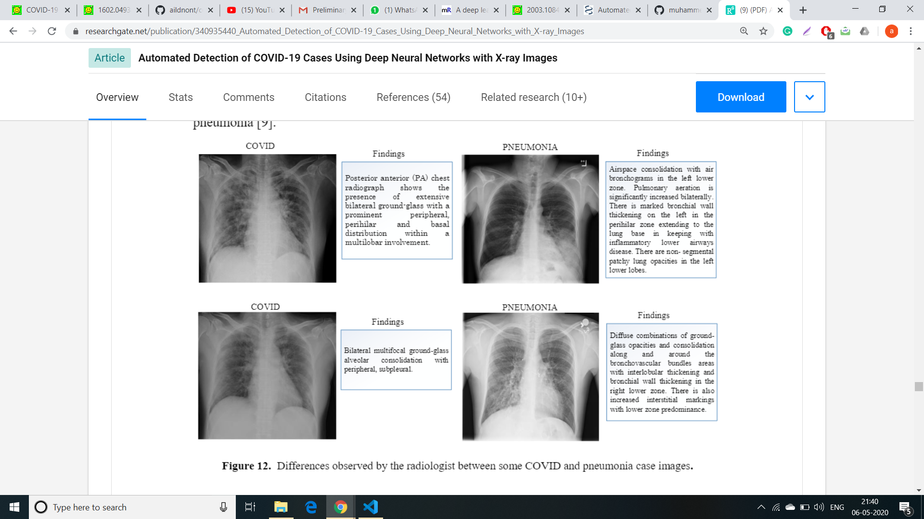
Kanne, J. P., Little, B. P., Chung, J. H., Elicker, B. M., & Ketai, L. H. (2020). Essentials for radiologists on COVID-19: an update—radiology scientific expert panel. Radiology, 200527.
Notes:
Thi figure shows the difference between a few COVID and pneumonia case images. The following primary findings are frequently observed in the chest X-rays of COVID-19 patients . Ground-glass opacities (GGO) (bilateral, multifocal, subpleural, peripheral, posterior, medial and basal). A crazy paving appearance (GGOs and inter- / intra-lobular septal thickening). Air space consolidation. Bronchovascular thickening (in the lesion). Traction bronchiectasis.
Similarly, chest X-ray findings of pneumonia patients are observed as follows . Ground-glass opacities (GGO) central distribution, unilateral Reticular opacity Vascular thickening Distribution more along the bronchovascular bundle Bronchial wall thickening.
In COVID-19, isolated lobar or segmental consolidation without GGO, multiple tiny pulmonary nodules, tree-in-bud, pneumothorax, cavitation, and hilar lymphadenopathy smoother interlobular septal thickening with pleural effusion are rare, while these findings can often be seen in pneumonia.

Slide 8
Recent advances in medical diagnosis using AI:
Kang Zhang at the University of California in San Diego and his colleagues trained an AI on medical records from 1.3 million patient visits at a major medical center in Guangzhou, China. The AI is able to diagnose glandular fever, roseola, influenza, chicken pox and hand-foot-mouth disease with 90 and 97 percent accuracy.
In a study published in Nature Medicine, using Google’s AI system, sourcing data 42,000 patient CT scans, the AI system outperformed 6 radiologists in diagnosing lung cancer. It improved the detection rate for lung cancer by 5%.
In April 2018, the FDA approved IDx-DR, a tool using AI to detect diabetic retinopathy by studying the images of the back of the eye. In the clinical study that led to the approval, the system detected diabetic retinopathy correctly 89.5% of the time. It’s the first tool of its kind that can be used for diagnosis without a doctor’s intervention.
Notes:
AI techniques have been successfully applied in many problems such as arrhythmia detection [28-30], skin cancer classification [31, 32], breast cancer detection [33, 34], brain disease classification [35], pneumonia detection from chest X-ray images [36], fundus image segmentation [37], and lung segmentation [38, 39] and they have achieved very high accuracies.

Slide 9

But they are still not used , why?
Usually availability of medical trained professionals and medical diagnostic methods doesn’t allow common people to believe on such AI systems.
And also most of the time it is not possible to explain why an AI system predicts what is does, or in other words what were the features that were observed were most crucial for the model to come at a certain conclusion.
But these are no ordinary times because the health systems of even developed countries are overburdened and we are facing acute shortage of trained medical experts and testing kits.
Many things which won’t happen ordinarily are being allowed to function to somehow cope with the pandemic therefore we believe this is the right time to rely on AI to predict on the basis of features present in X-Ray unique to covid infected individuals which an untrained Doctor’s eye may not be able to distinguish from pneumonia.
Notes:
To add: lime works on trust. registered can add more images .

Slide 10

Dataset
We had 100 images of positive cases of Covid-19,which we randomly split into 59 for training and 41 for testing.
The training dataset consisted of normal cases i.e those cases which didn’t have any disease,Positive cases of Bacterial Pneumonia,Positive cases of Viral Pneumonia and Positive cases
Of Bacterial Pneumonia.
These images help in increasing the robustness of the model,since it is difficult even for doctors to distinguish between pneumonia and
Covid-19.

Slide 11
Methodology
In recent years, Deep Learning models have greatly improved analysis and helped medical professionals around the world save many lives due to quick diagnoses. We present two approaches to predicting
CNN Model :- Since X-Rays constitute more than 75% of the total radiological image data,Deep Learning networks,primarily Convolutional Neural Networks or CNNs,have been applied extensively on them for automated image interpretation.
Gradient Boosting model :- Although highly accurate, CNN models, lack explainability. Hence for determining certain measurable factors, that are important for giving a proper reasoning for a prediction. Also the parameters we have used are which can be determined via a normal blood test.

Slide 12

CNN Model
We built a CNN model,consisting of 2D convolutional layers,average pooling layers and fully connected layers.
We used the Rectified Linear Unit or ReLu activation function for the hidden layers and the Sigmoid function for the final output.
The “adam” optimizer function was used to achieve faster training and to better minimize the loss function.
To maximize the recall,and to get minimum number of False Negatives in the final result,we modified the loss function to incur a heavier penalty when a positive case was classified as negative.

Slide 13
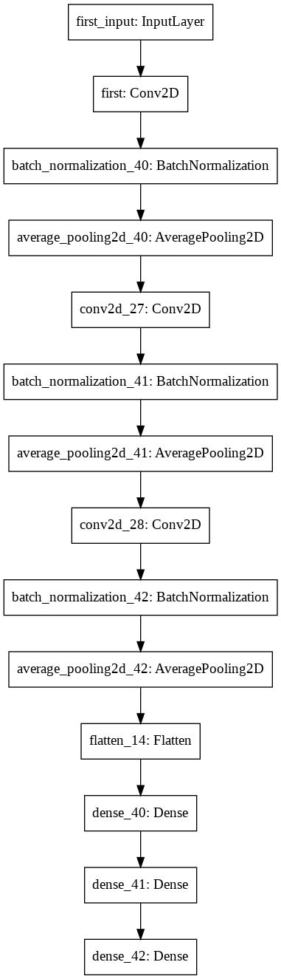
Outline of the Model
Input Image
2D Convolution Layer Containing 32 filters,”ReLu” activation
2D Convolution Layer Containing 128 filters,”ReLu” activation
2D Convolution Layer Containing 256 filters,”ReLu”
activation
Batch Normalization and Average Pooling were applied after each convolution
Flattened Layer
Fully Connected Dense Layer,512 nodes,”ReLu” activation
Fully Connected Dense Layer,128 nodes,”ReLu” activation
Output Layer,”Sigmoid” activation

Slide 14

Results
We performed 10 fold stratified testing for our model.
Average training accuracy -98.878%
Average test accuracy -98.759%
Average negative case recall -99.300%
Average positive case recall -90.240%
We tested the model on separate dataset of 41 positive cases and the model predicted 37 cases correctly:90.24% accuracy.
Link for the model

Slide 15
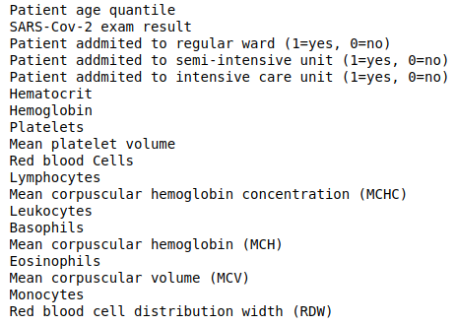
Dataset
The dataset that we used as for the boosting model was from Brazil.
This dataset contains anonymized data from patients seen at the Hospital Israelita Albert Einstein, at Sao Paulo, Brazil, and who had samples collected to perform the SARS-COV-2 RT-PCR and additional laboratory tests during a visit to the hospital. The dataset was normalized, and we used the following features
features for modelling.

Slide 16
Gradient Boosting model
First of all the data was cleaned, as the dataset contained a large number of null values.
We used Xgboost(Extreme gradient boosting), which is a special type of gradient boosting technique,
To maximize the recall,and to get minimum number of False Negatives in the final result,we modified the loss function to incur a heavier penalty when a positive case was classified as negative.

Slide 17
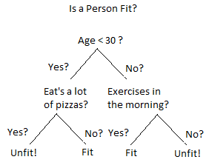
Outline of the Model
Boosting is a well known technique where multiple weak learners are combined to make a good learner. In case of gradient boosting, the weak learner are decision trees.
Such a tree is built through a process of binary recursive partition of the dataset, till no further partition is possible.
Gradient Boosting consists of 3 elements :-
Loss function :- The objective is to minimize the loss function, which depends on the correct predictions.
Weak learner :- Regression decision trees are the weak learners, so that they can be added
Adding Trees :- Trees are added, two at a time, and gradient descent is used to minimize loss function during merging.
Besides the above xgboost uses many other techniques to reduce time consumption, and improve learning of the model.

Slide 18
Results
We performed 4 fold stratified testing for our model.
Average training accuracy -87.878%
Average test accuracy - 85.69%
Average test AUC-ROC score - 0.8883
Average positive case recall -71.07%
Link to Model :- https://colab.research.google.com/drive/1VbCHW_TlSB80Cz-Yr55cmkXAT1neqmDm

Slide 19

Why should medical professionals trust it?
This model is a prototype system does not offer a standalone diagnosis.
Since the predictions made by this model may be used by healthcare providers to benefit patients, it is imperative that the model's predictions may be explained so as to ensure that the it is making responsible predictions. Model explainability promotes transparency and accountability of decision-making algorithms.
Since this model is a neural network, it is difficult to decipher which rules or heuristics it is employing to make its predictions and therefore we use LIME(Local Interpretable Model-agnostic Explanations)

Slide 20
Contd.
Adding to that we have a gradient boosting model to provide a strong reasoning for every positively predicted case.
A gradient boosting model inherently generates the importance of each feature while learning to predict.
This combined with lime can provide a strong reasoning as to whether a model behaves as it does.

Slide 21
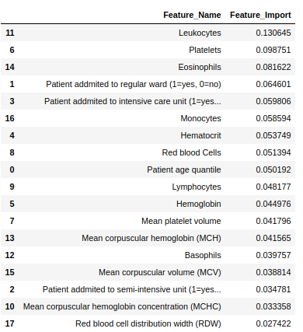
Explanation of results :- Boosting model
The top three important features include Platelets, Leukocytes, and Eosinophils. Eosinophils and Leukocytes are a type of WBC, that get activated when a foreign particle enters human body, hence indicate the presence of foreign contamination.
Decline in platelet count or Thrombocytopenia in people with COVID-19 with progression of time has been observed. Platelet count is therefore in direct correlation with infections.
Source :- https://onlinelibrary.wiley.com/doi/full/10.1111/jth.14848

Slide 22
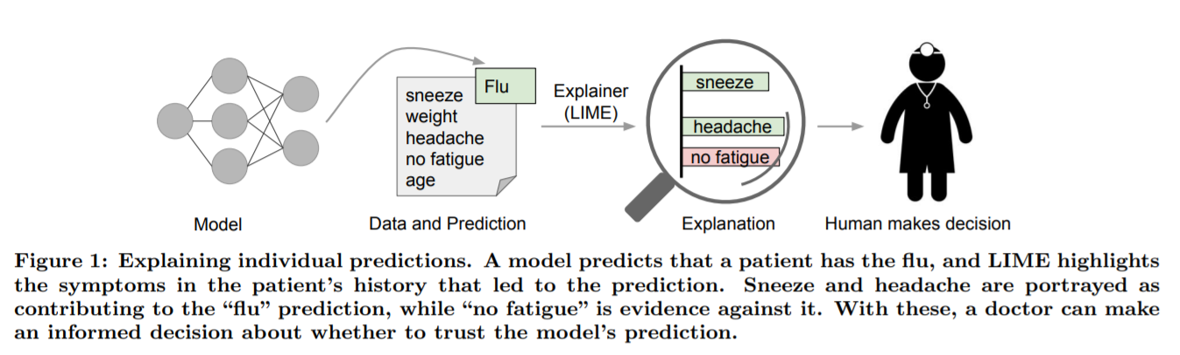
About LIME: “Trust is crucial for effective human interaction with machine learning systems”
LIME, an algorithm that can explain the predictions of any classifier or regressor in a faithful way, by approximating it locally with an interpretable model.
As illustrated in below it is clear that a doctor is much better positioned to make a decision with the help of a model if intelligible explanations are provided.
In this way, we have ensured that the outcome of the model is approved by a radiologist before confirming the prediction.
Source:https://arxiv.org/pdf/1602.04938.pdf

Slide 23
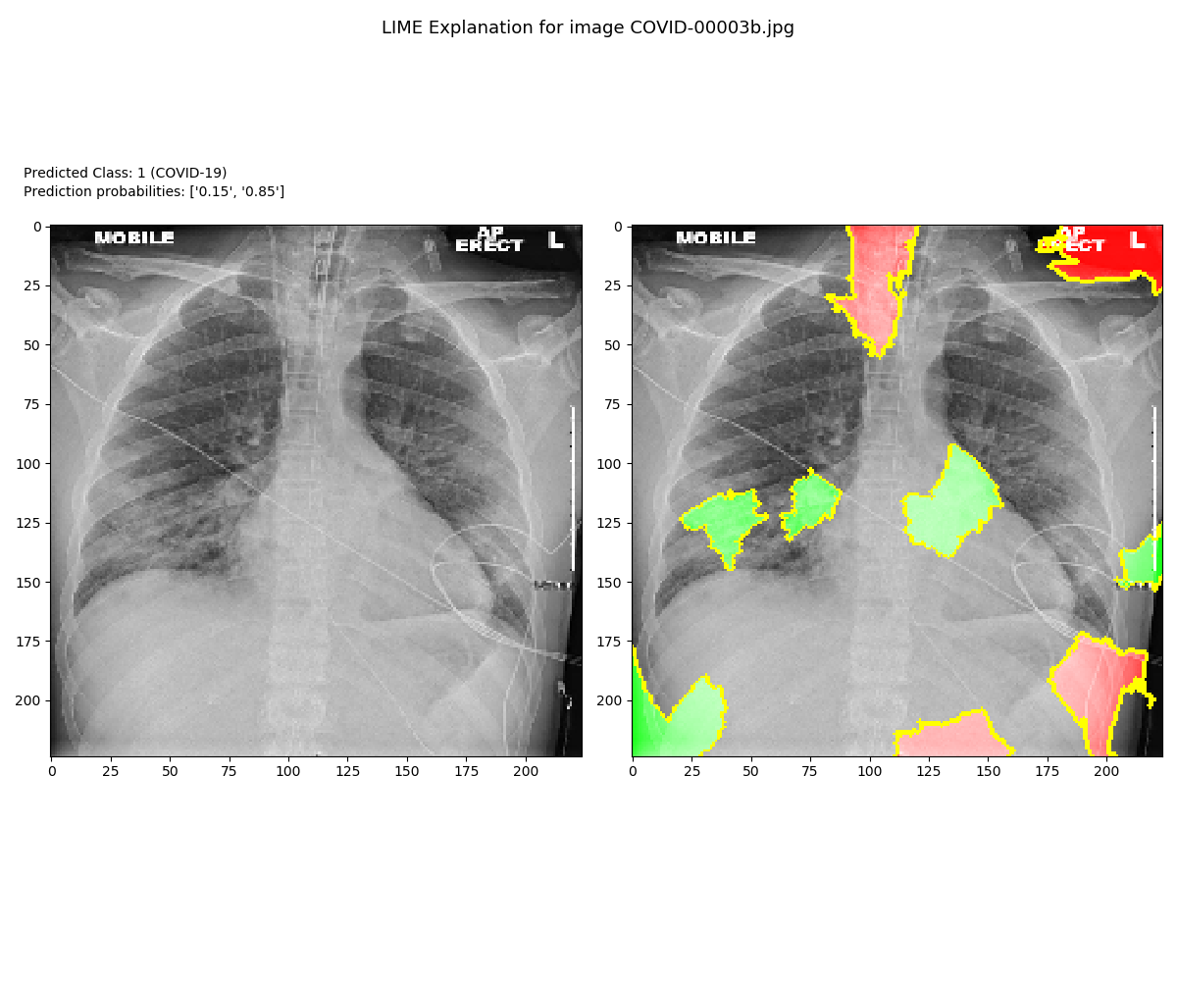

Using LIME
Covid positive

Slide 24
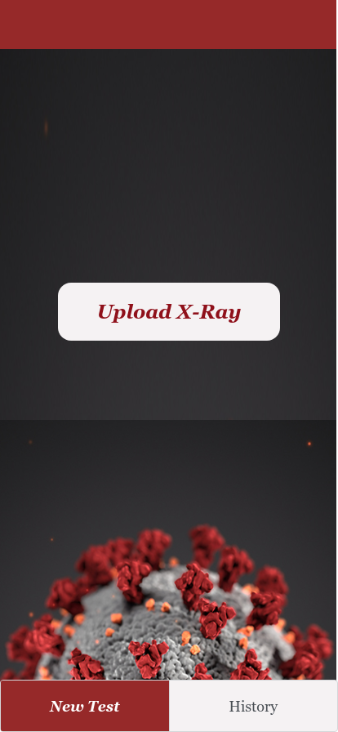
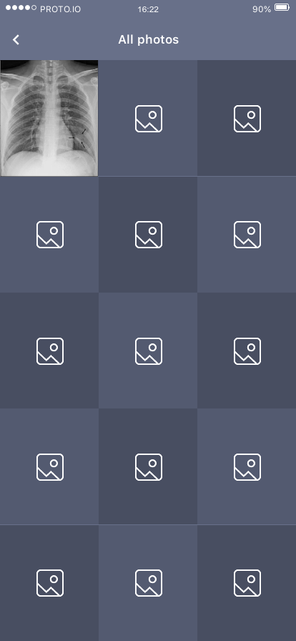
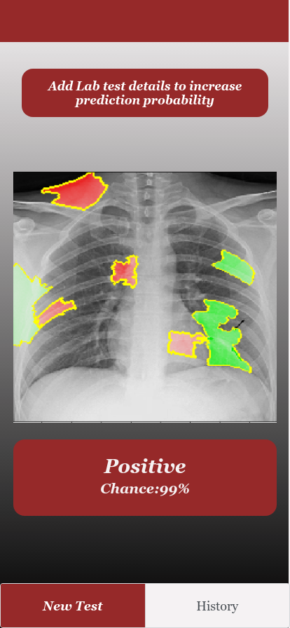
https://pr.to/IL30MC/

Slide 25
Thank You
For Your Attention

Slide 26


